Slide 1
Employee Data Analysis using Excel
STUDENT NAME : S.ABINANDHANAA
REGISTER NO:122201986
DEPARTMENT: BCOM(C.S)
COLLEGE : ANNA ADARSH COLLEGE FOR WOMEN

Slide 2
PROJECT TITLE
Employee Performance Analysis using Excel

Slide 3


AGENDA
Problem Statement
Project Overview
End Users
Our Solution and Proposition
Dataset Description
Modelling Approach
Results and Discussion
Conclusion
3/21/2024 Annual Review

Slide 4

PROBLEM STATEMENT Employee performance evaluations will help you know if your employees are performing up to the standards and expectations. The purpose is to learn more about their strengths and weakness, offer constructive feedback for skill development in the future, and assist in the job .

Slide 5

PROJECT OVERVIEW
Analyzing the performance of the employee by considering various factors like gender performance , achievements etc , is known as employee performance analysis and also to find out the trends and patterns of high medium and low .
Companies use employee performance evaluations as a tool to document an employees performance over time.

Slide 6

WHO ARE THE END USERS?
Human Resources (HR) Professionals: They use performance analysis to manage employee development, recruitment, and compliance.
Managers and Team Leaders: They rely on performance data to make decisions about promotions, raises, and professional development.
Executives and Senior Leadership: They use performance analysis to gauge overall organizational effectiveness and align performance with strategic goals.
Employees Themselves: They receive feedback for personal development and career progression.
Training and Development Teams: They use performance insights to design targeted training programs.
Payroll and Compensation Specialists: They use performance metrics to inform compensation decisions and incentives.

Slide 7

OUR SOLUTION AND ITS VALUE PROPOSITION 1. Conditional formatting – to highlight the missing values 2. Filtering – to remove the missing values 3. Formula – to calculate the employee performance level 4. Pivot- to summarize 5.Graph- for data visualization 6. Pie chart – for data visualization

Slide 8
Dataset Description EMPLOYEE PERFORMANCE ANALYSIS DATA SET IS TAKEN FROM EDUNET DESCRIPTION TOTAL FEATURES – 26 , FEATURES TAKEN FOR CONSIDERATION – 9 EMP ID –NUMBER NAME-TEXT EMPLOYEE TYPE PERFORMANCE LEVEL GENDER-MALE FEMALE EMPLOYEE RATING – NUMBER BUSINESS TYPE FIRST NAME LAST NAME EXIT DATE ( USING CONDITIONAL FORMATTING )

Slide 9

THE "WOW" IN OUR SOLUTION Performance level formula : =IFS(Z8>=5,”VERY HIGH”,Z8>=4,’HIGH”,Z8>=3,”MED”,”TRUE”,”LOW”)
3/21/2024 Annual Review
9

Slide 10
MODELLING
1. Collection: collected the data from EDUNET data set which was mentioned in the class
2. Feature collection : selected 9 specific features from the total of 26 features
3. Data cleaning :
a) Identifying the missing values
b) Filtering the missing values
4. Performance level:
Applied the performance level formula =IFS(Z8>=5,”VERYHIGH”,Z8>=4,’HIGH”,Z8>=3,”MED”,”TRUE”,”LOW”)
5. Summary:
a) Using the pivot table classify the necessary fields
b) Highlight the necessary data
6. Visualization:
Recommended graph
Pie chart
10

Slide 11
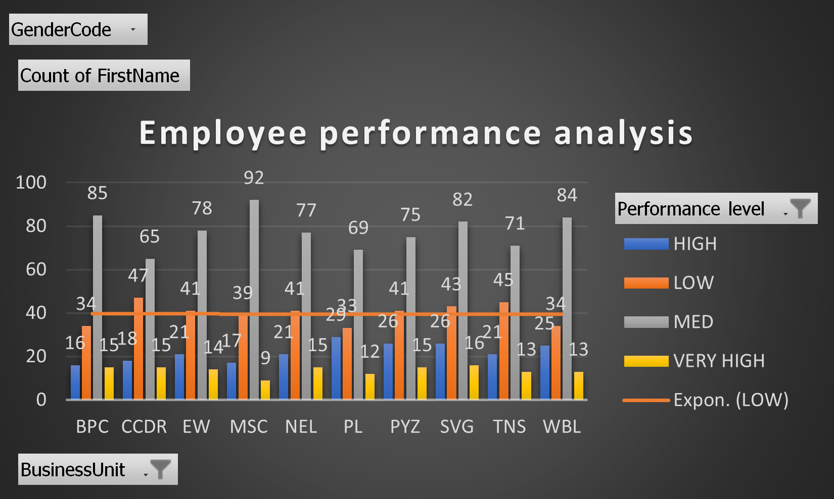
RESULTS
11

Slide 12
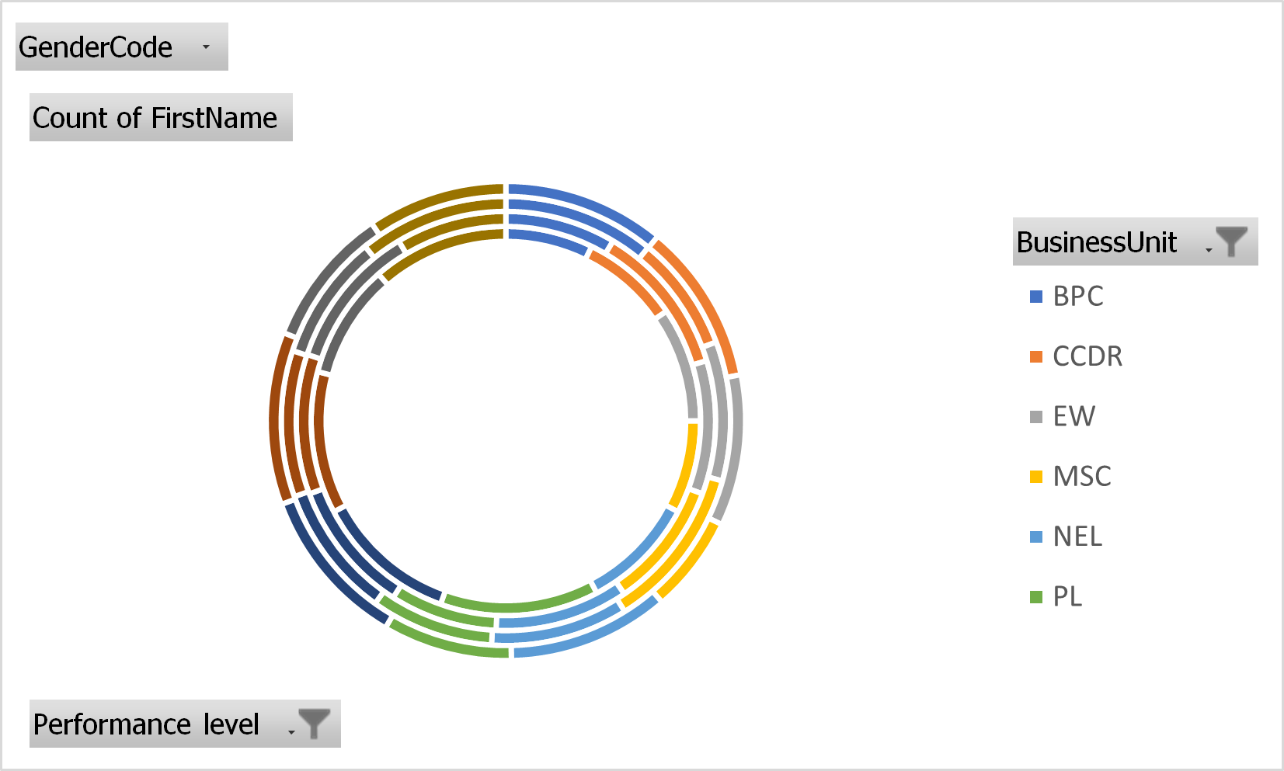
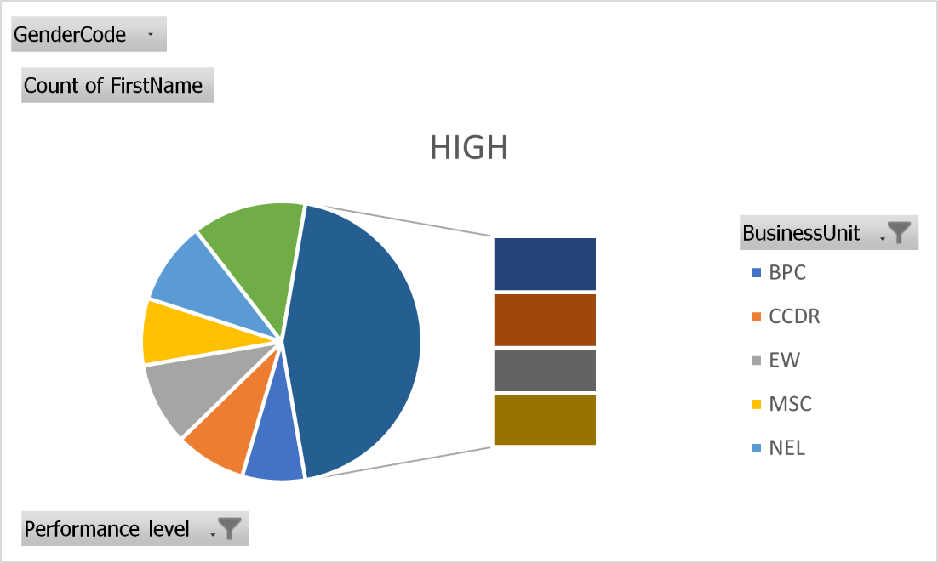
RESULT

Slide 13
CONCLUSION: According to the graph, the performance of the employees are expo line low of 40 and there are classifications of high, very high, and medium.

